Slide 1
Visual Design and Impact
WRD 110
5 November 2021

Slide 2
Group Work (5 points)
In groups of 4 or 5, discuss “Hispanic Students at the University of Kentucky” (you can pull it up on your devices). Have one group member write your responses and turn them in at the end of class.
Describe how the images and text are arranged in this photo essay. What is the impact?
  Consider balance, unity, emphasis, visual hierarchy, etc
What colors, forms, or textures are evident in this photo essay? How do they affect your reading?
What does the visual element of this photo essay add to the topic or argument?
  Consider how it might function if it were just a regular written essay

Slide 3
Visual Rhetoric and Design Terms
Unity: “sense of order, a sense that all the things being talked about are tied together for a reason” (TB 338)
  Consider proximity, repetition, alignment, and containment
Emphasis: “one part sticks out boldly and becomes a focal point” (TB 340)
  Consider isolation, placement, and contrast
Juxtaposition: placing two (often different) things near each other to expose differences between the two
Symmetrical balance: “visual elements of two sides of a central axis mirror each other” (TB 344)
Asymmetrical balance: “balancing one visually interesting form with another” (TB 345)
Visual hierarchy: emphasizing that which is most different from the rest (TB 346)

Slide 4
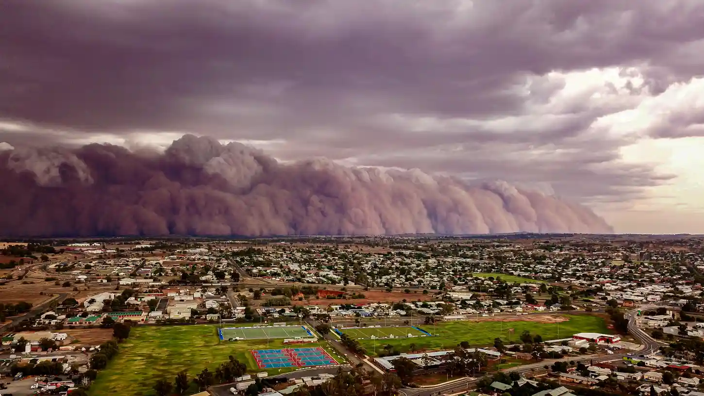
Dust and rain storm at Parkes, NSW, Australia

Slide 5
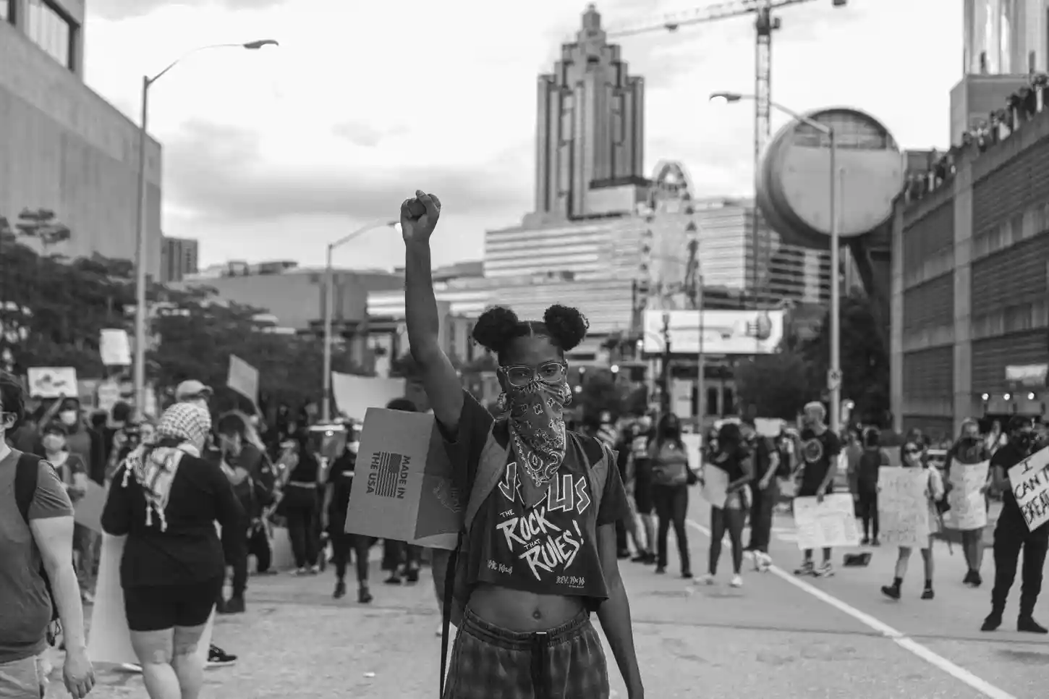
BLM protester in Atlanta, Georgia

Slide 6
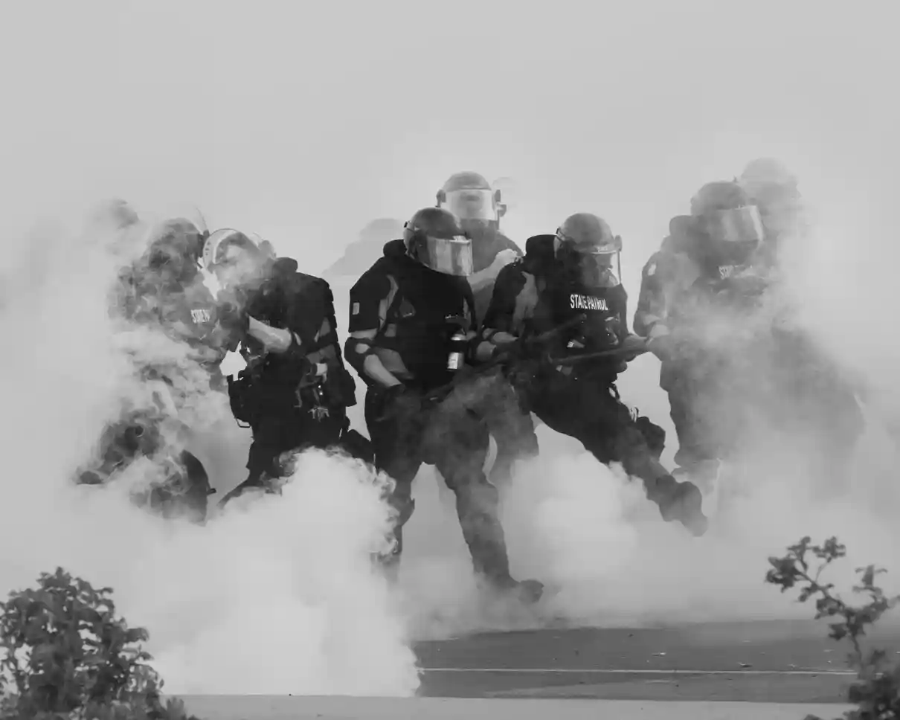
Protests over the killing of George Floyd in Minneapolis

Slide 7
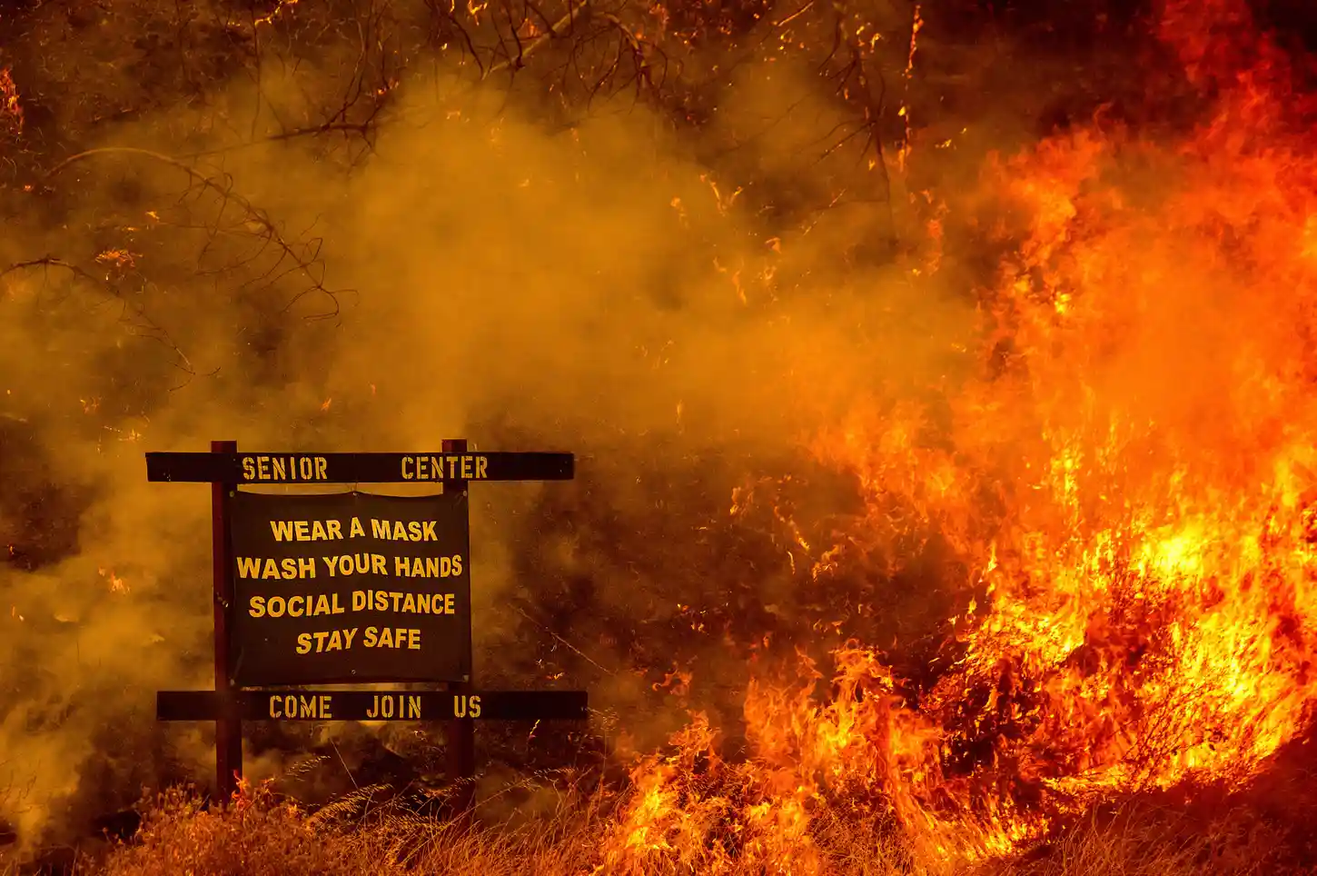
Wildfire and covid in California

Slide 8
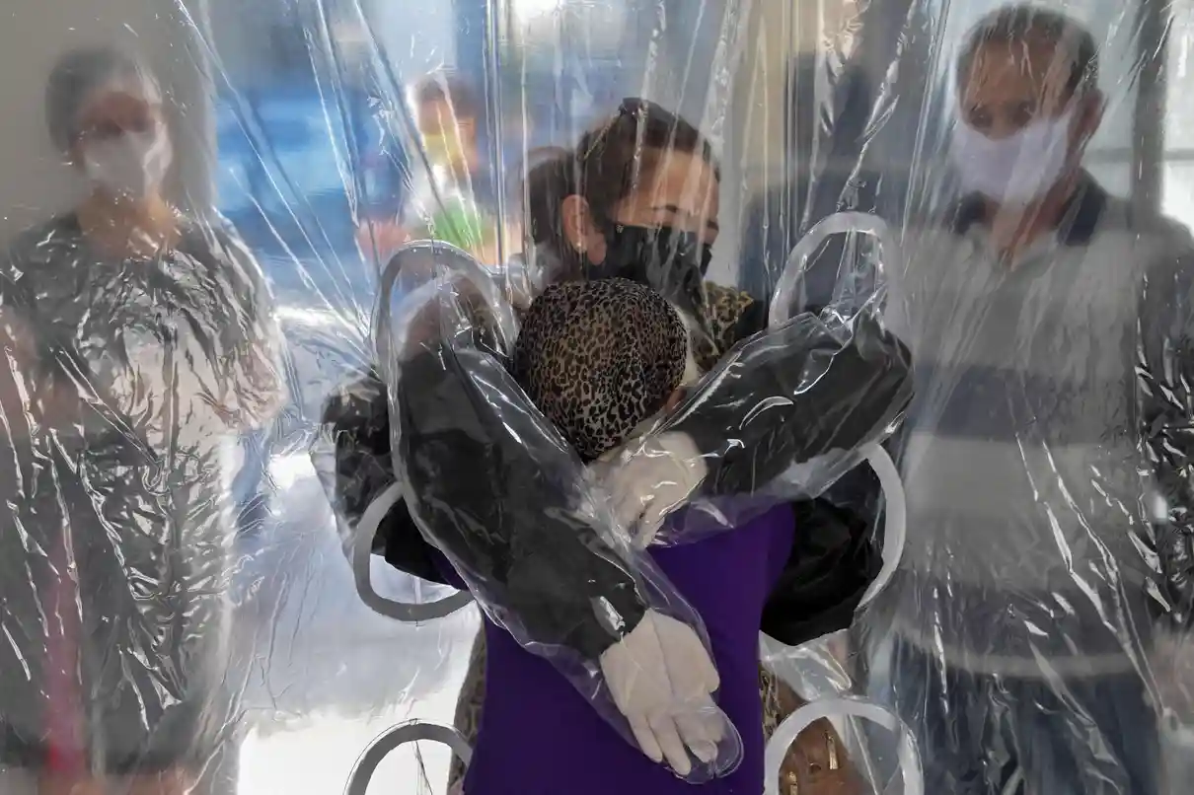
A hug through the covid safety curtain in Sao Paolo

Slide 9
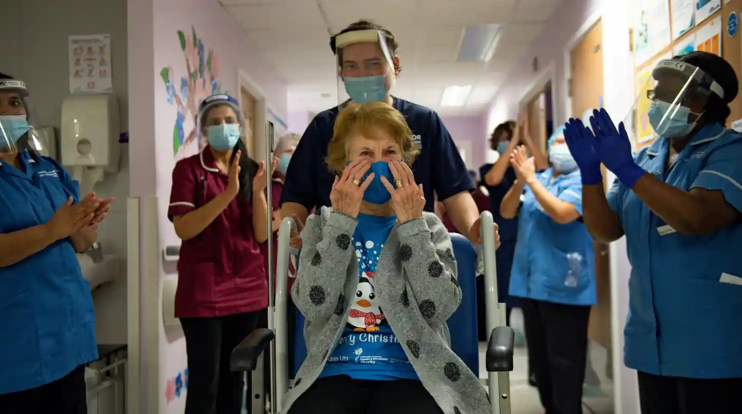
Margaret Keenan becomes the first person in the UK to receive the Pfizer/BioNTech covid-19 vaccine

Slide 10
Quick Group Chat
With the group you worked with at the beginning of class, consider how you would arrange the six photos we just viewed in a photo essay about the shitshow that was 2020.
How would you order or arrange the photos? Side-by-side? One after another? In a grid? Something else?
How would you create unity? How would you create emphasis?
What images would you put together, and how?
  Theme, color, form
What kind of meaning could you create through your arrangement?

Slide 11
Let’s Take Some Photos
Stay in your groups. You will now arrange and take three photos, one representing unity, one representing emphasis, and one representing juxtaposition. You may use yourselves, props, campus scenery, etc (just be sure to ask permission before photographing other people). Then, email those photos to me.
The class will try to guess which visual design term you were attempting to represent, so be sure to keep everything a secret.

Slide 12
For Monday
Read “Waffle House Vistas” from The Bitter Southerner (modules → photo essays)

